Slide 1
INHERITANCE

Slide 2
Basics
The process by which one class acquires the properties(data members) and functionalities(methods) of another class is called inheritance.
Provide the reusability of code
Child Class(sub class or derived class)
Parent Class(super class or Base class)

Slide 3
SYNTAX
class XYZ extends ABC
{
}

Slide 4
class Calculation {
int z;
public void addition(int x, int y) {
z = x + y;
System.out.println("The sum of the given numbers:"+z);
}
public void Subtraction(int x, int y) {
z = x - y;
System.out.println("The difference between the given numbers:"+z);
}
}

Slide 5
public class My_Calculation extends Calculation {
public void multiplication(int x, int y) {
z = x * y;
System.out.println("The product of the given numbers:"+z);
}
public static void main(String args[]) {
int a = 20, b = 10;
My_Calculation demo = new My_Calculation();
demo.addition(a, b);
demo.Subtraction(a, b);
demo.multiplication(a, b);
}
}

Slide 6
The super keyword
It is used to differentiate the members of superclass from the members of subclass, if they have same names.
It is used to invoke the superclass constructor from subclass
super.variable
super.method()

Slide 7
class Super_class {
int num = 20;
// display method of superclass
public void display() {
System.out.println("This is the display method of superclass");
}
}
public class Sub_class extends Super_class {
int num = 10;
// display method of sub class
public void display() {
System.out.println("This is the display method of subclass");
}

Slide 8
public void my_method() {
// Instantiating subclass
Sub_class sub = new Sub_class();
// Invoking the display() method of sub class
sub.display();
// Invoking the display() method of superclass
super.display();
// printing the value of variable num of subclass
System.out.println("value of the variable named num in sub class:"+ sub.num);
// printing the value of variable num of superclass
System.out.println("value of the variable named num in super class:"+ super.num);
}
public static void main(String args[]) {
Sub_class obj = new Sub_class();
obj.my_method();
}
}

Slide 9
example
class Employee{
float salary=40000;
}
class Programmer extends Employee{
int bonus=10000;
public static void main(String args[]){
Programmer p=new Programmer();
System.out.println("Programmer salary is:"+p.salary);
System.out.println("Bonus of Programmer is:"+p.bonus);
}
}

Slide 10
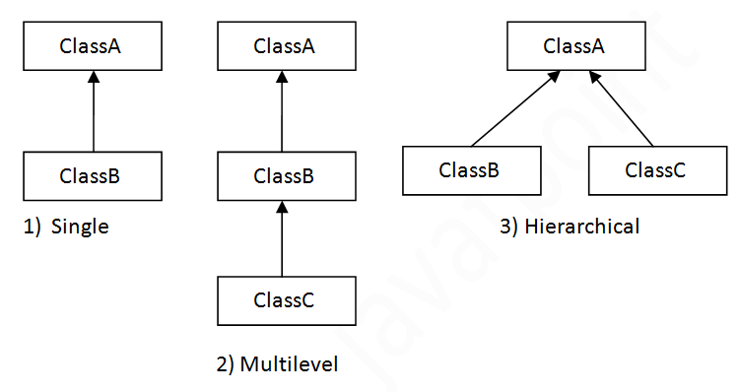
Types of inheritance in java

Slide 11
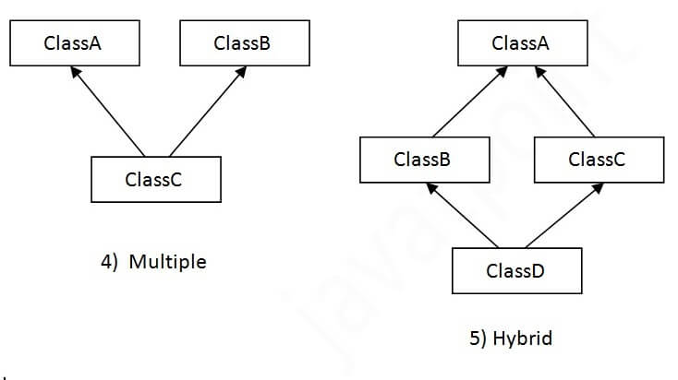
Possible??

Slide 12
Single Inheritance Example
class Animal{
void eat()
{
System.out.println("eating...");}
}
class Dog extends Animal{
void bark()
{ System.out.println("barking...");}
}
class TestInheritance{
public static void main(String args[]){
Dog d=new Dog();
d.bark();
d.eat();
}}

Slide 13
Multilevel Inheritance Example
class Animal{
void eat(){System.out.println("eating...");}
}
class Dog extends Animal{
void bark(){System.out.println("barking...");}
}
class BabyDog extends Dog{
void weep(){System.out.println("weeping...");}
}
class TestInheritance2{
public static void main(String args[]){
BabyDog d=new BabyDog();
d.weep();
d.bark();
d.eat();
}}

Slide 14
Hierarchical Inheritance Example
class Animal{
void eat(){System.out.println("eating...");}
}
class Dog extends Animal{
void bark(){System.out.println("barking...");}
}
class Cat extends Animal{
void meow(){System.out.println("meowing...");}
}
class TestInheritance3{
public static void main(String args[]){
Cat c=new Cat();
c.meow();
c.eat();
//c.bark();//C.T.Error
}}

